Slide 1

Applying for State Phytosanitary Certificates through PCIT
(Phytosanitary Certificate Issuance & Tracking System)

Slide 2
Steps for applying for a State Phytosanitary Certificate through PCIT
The next few slides will show the steps for creating an account through E-Authentication and applying for a State Phytosanitary Certificate through PCIT
Please follow the slides in order to create your account and apply for a State Phytosanitary Certificate.
Below is the web address to begin the process and the web address for PCIT once you have created your account.
https://www.eauth.usda.gov/eauth/b/usda/home
https://pcit.aphis.usda.gov/pcit/faces/signIn.jsf

Slide 3
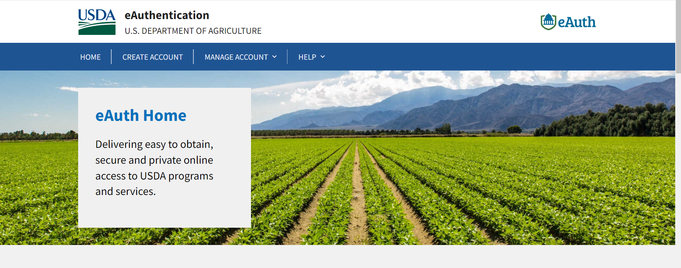
E-Authentication Home-
Choose “CREATE ACCOUNT”

Slide 4
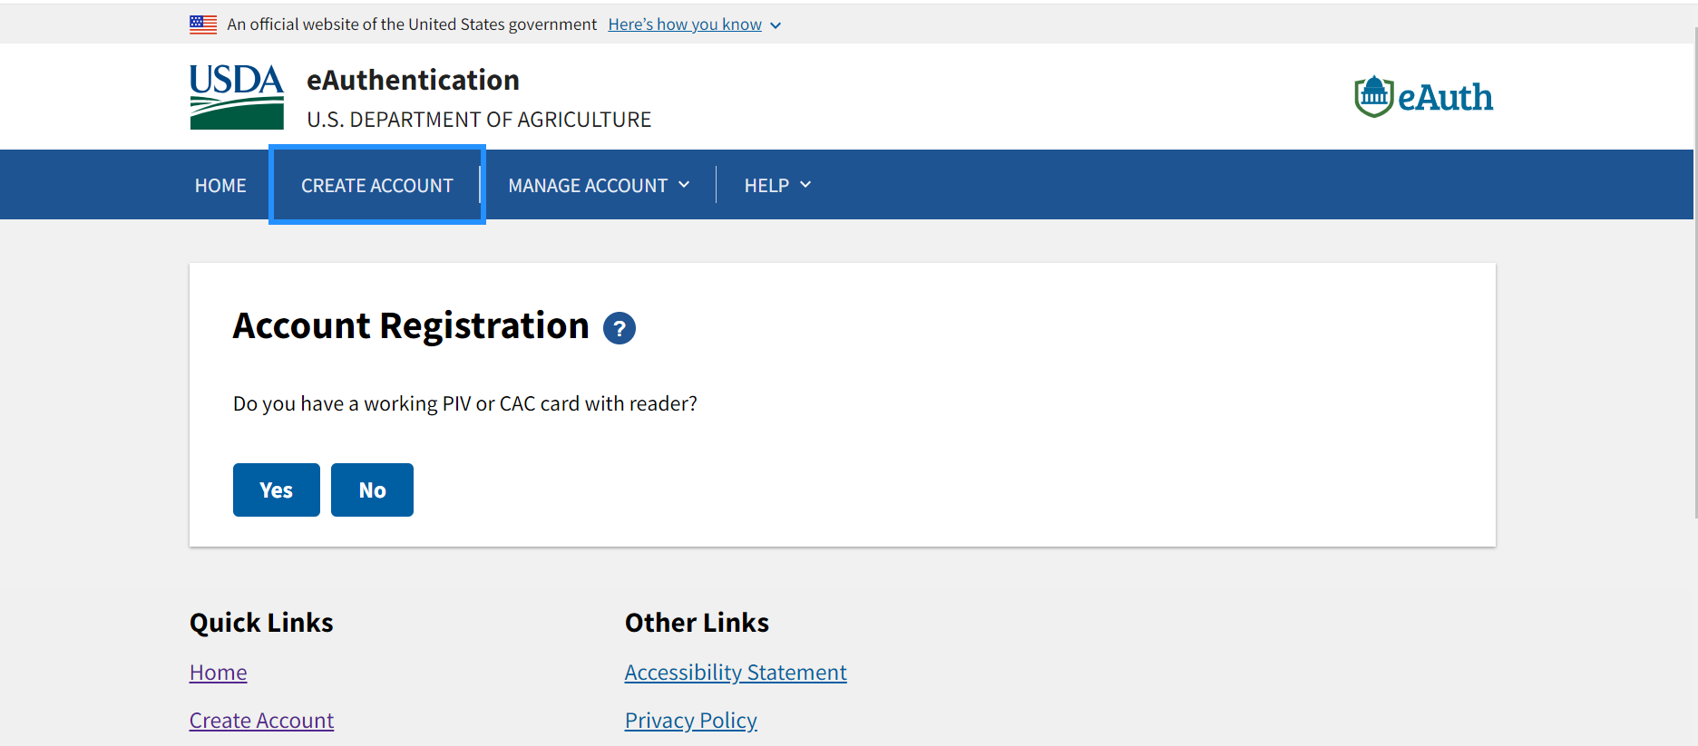
Choose “No” on this screen

Slide 5
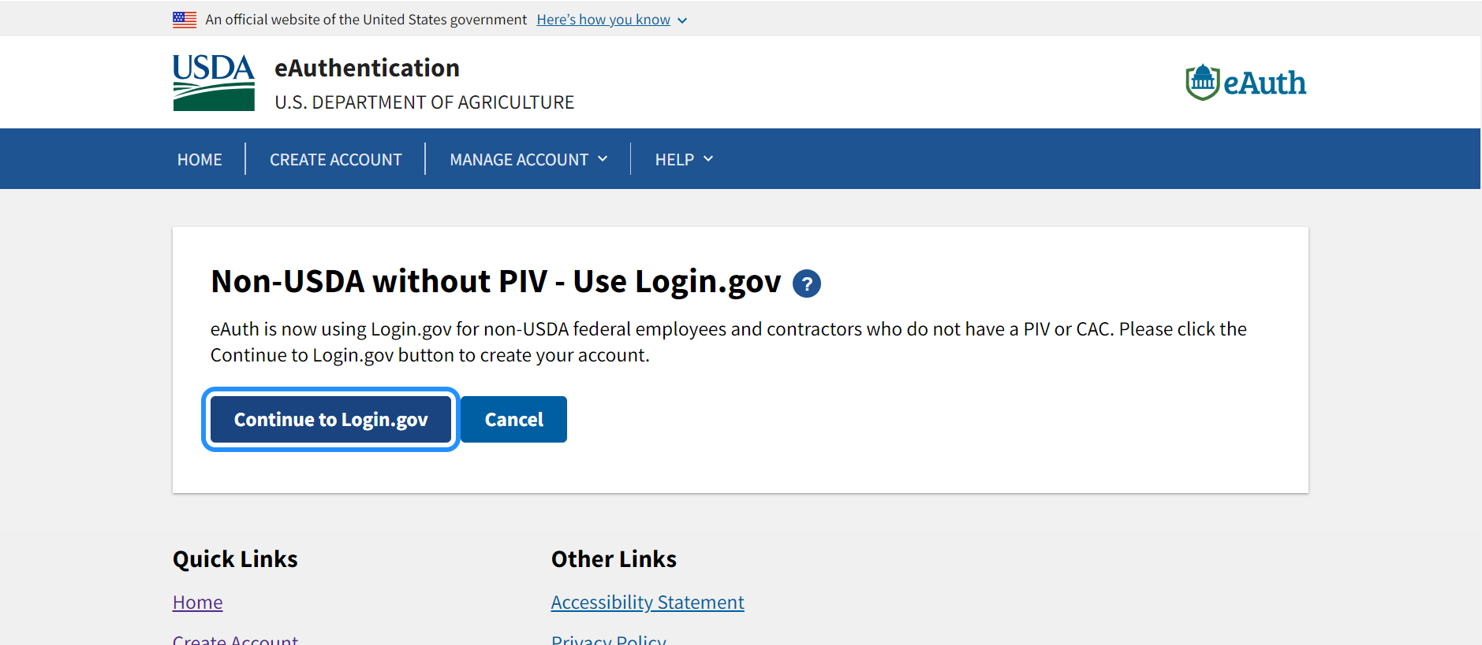
Choose “Continue to Login.gov”

Slide 6
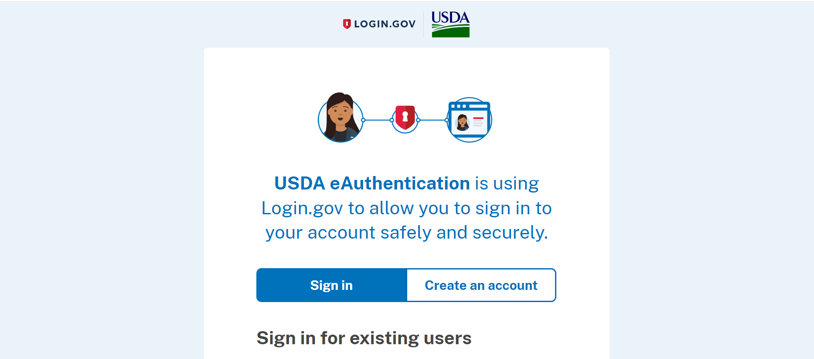
Choose “Create an Account”- this is where you will create a username and password.

Slide 7
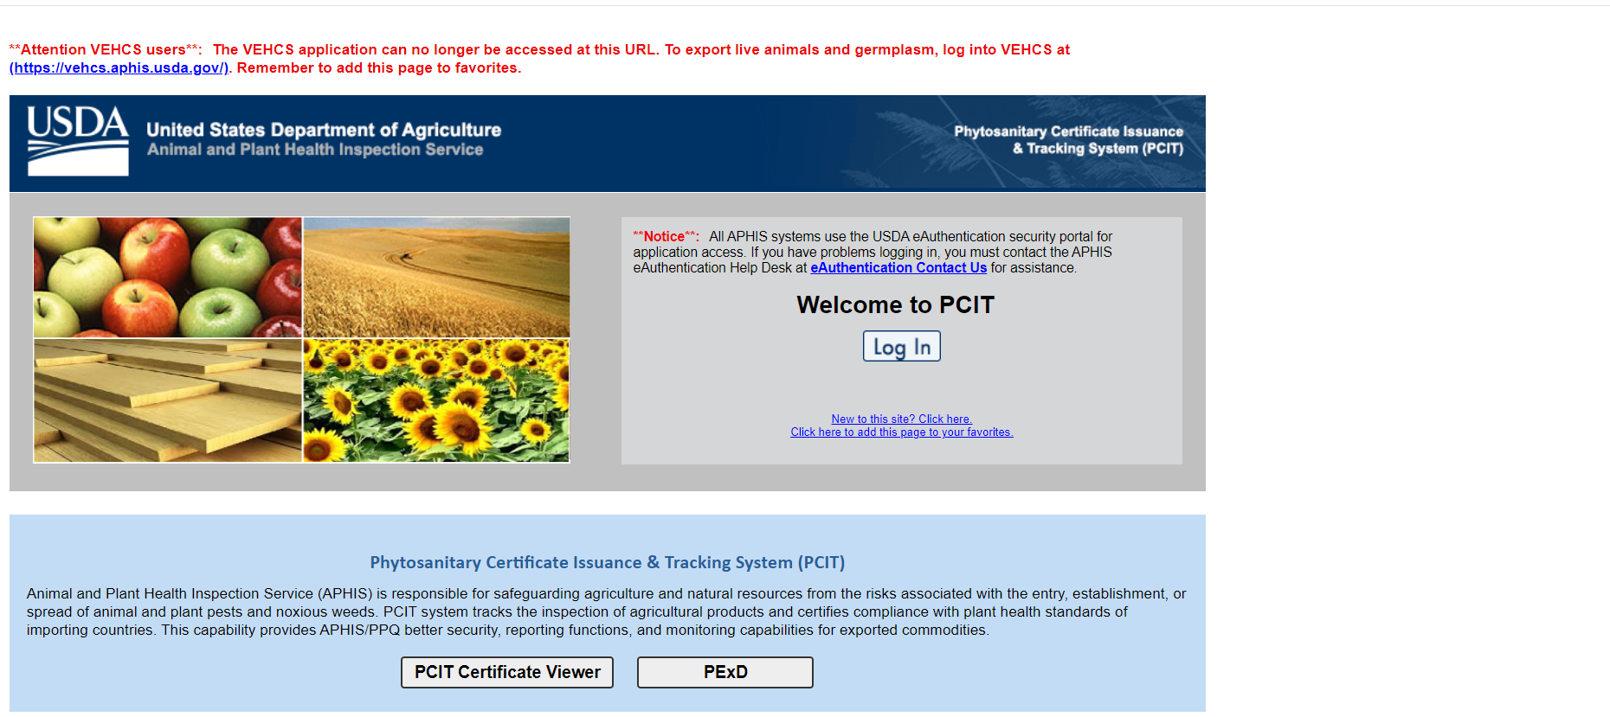
Once you have created an E-Authentication account, go to the PCIT website at bottom right. Choose “Log In”
https://pcit.aphis.usda.gov/pcit/faces/signIn.jsf

Slide 8
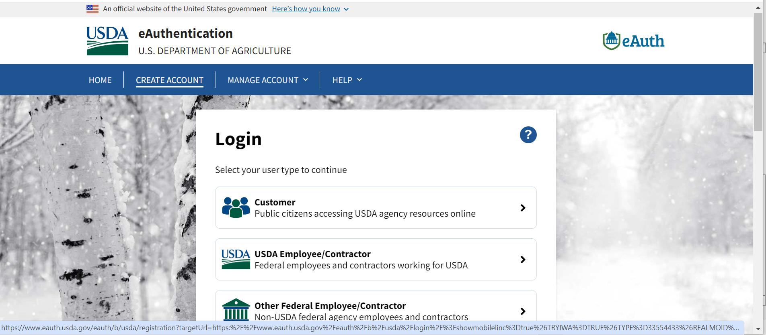
Choose “Customer”

Slide 9
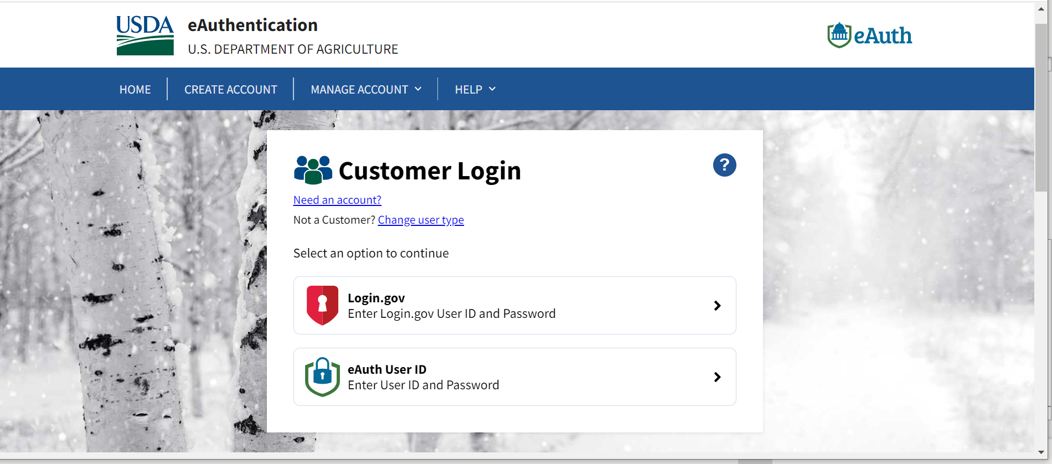
Choose “Login.gov”

Slide 10
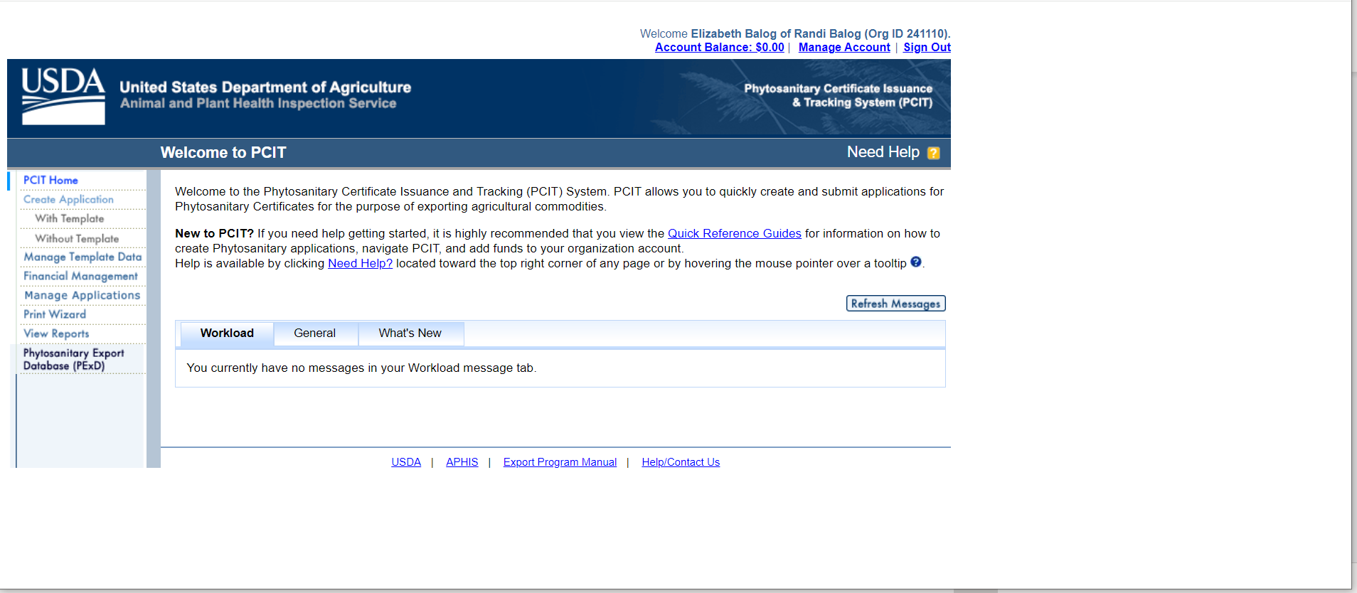
Choose “Create Application”
At the beginning, you will need to create a template. You will also be able to save consignees and exporters when needed.

Slide 11
Once logged in, this will be your home screen.

Slide 12
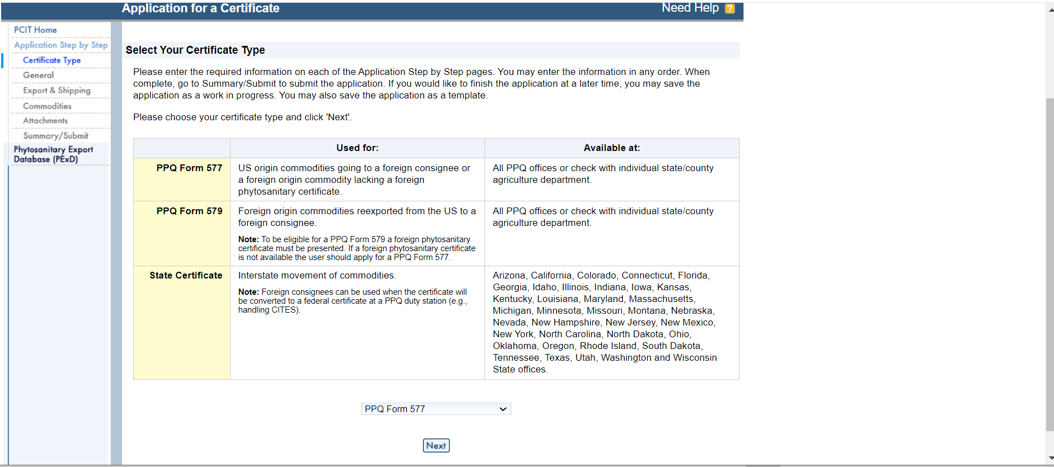
To Create an Application, first choose a certificate type.

Slide 13
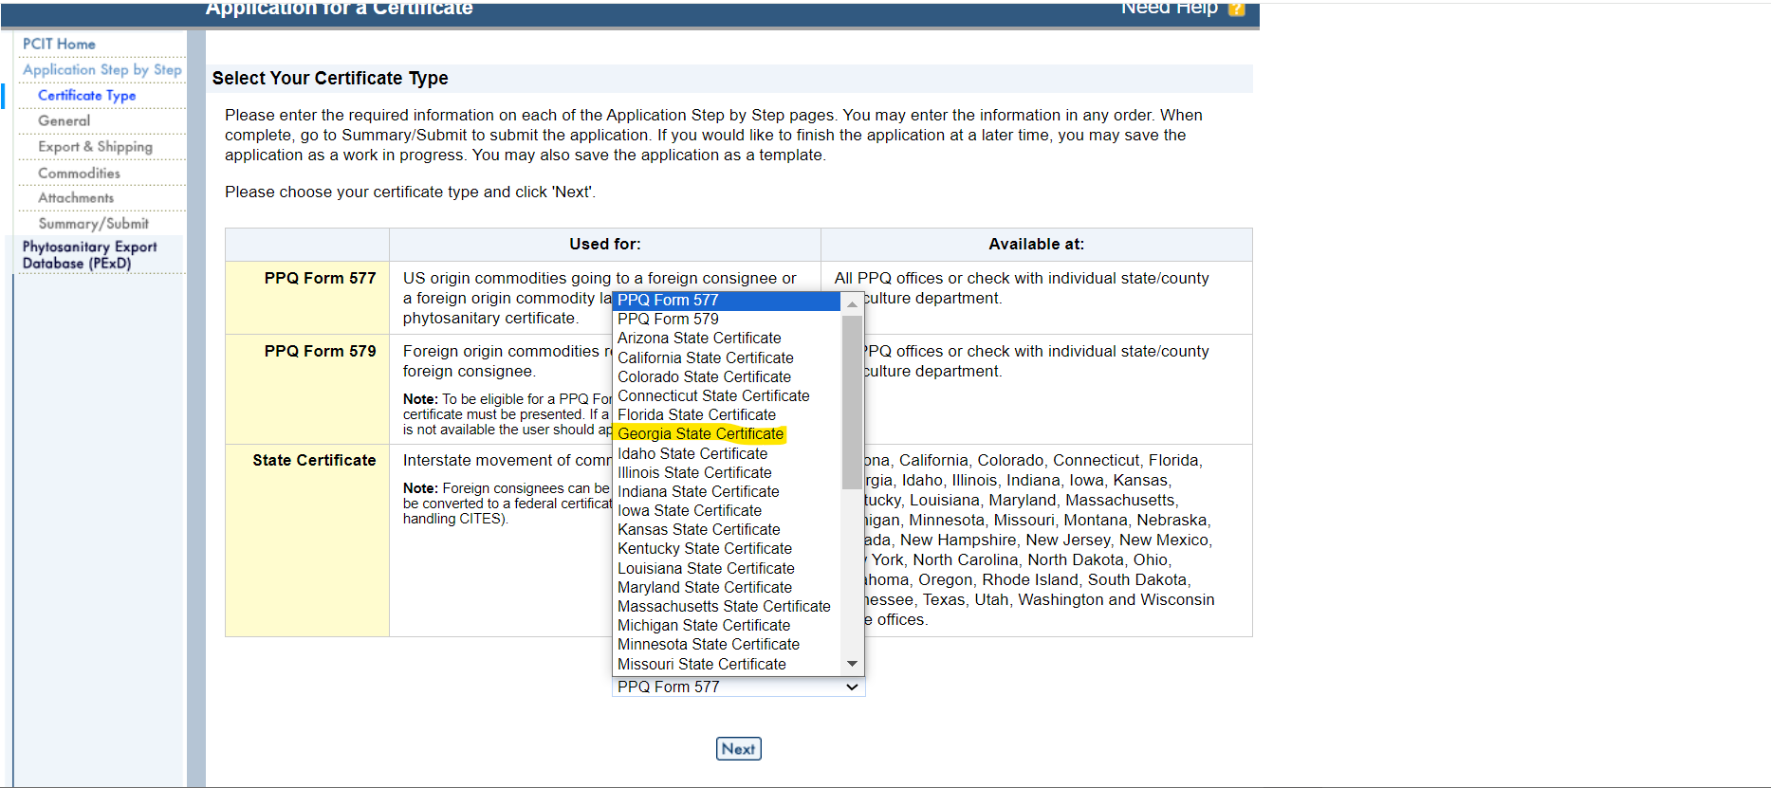
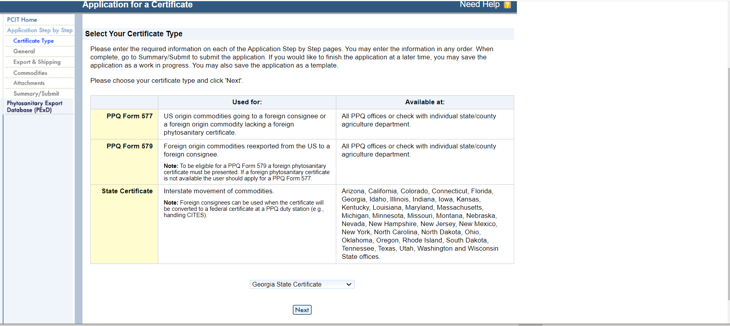
Click on dropdown box on the bottom of the screen
Choose “Georgia State Certificate”
Choose “Next”

Slide 14
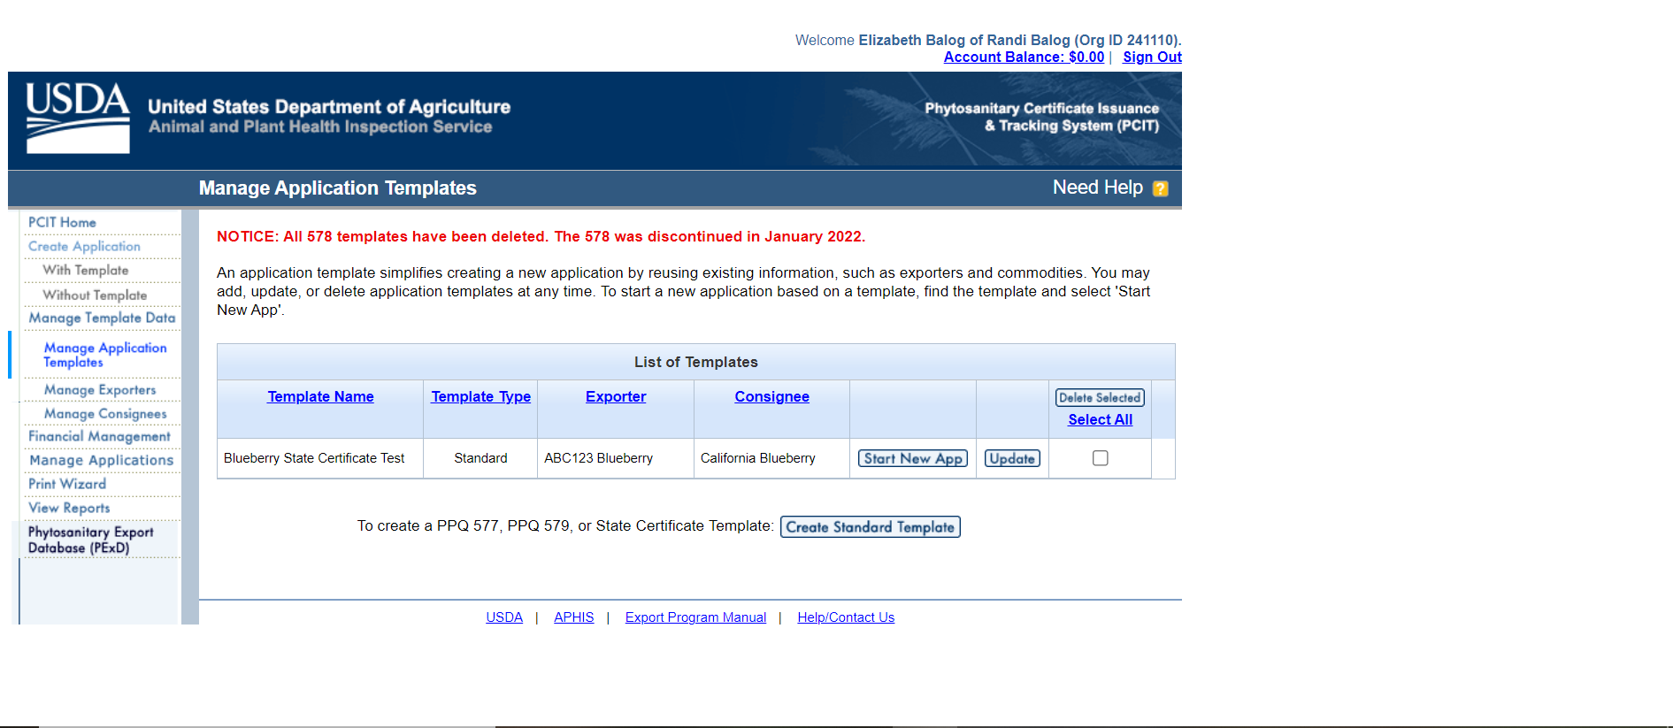
Once you have created templates, applying will be much faster. You will also be able to save multiple consignees and exporters.

Slide 15
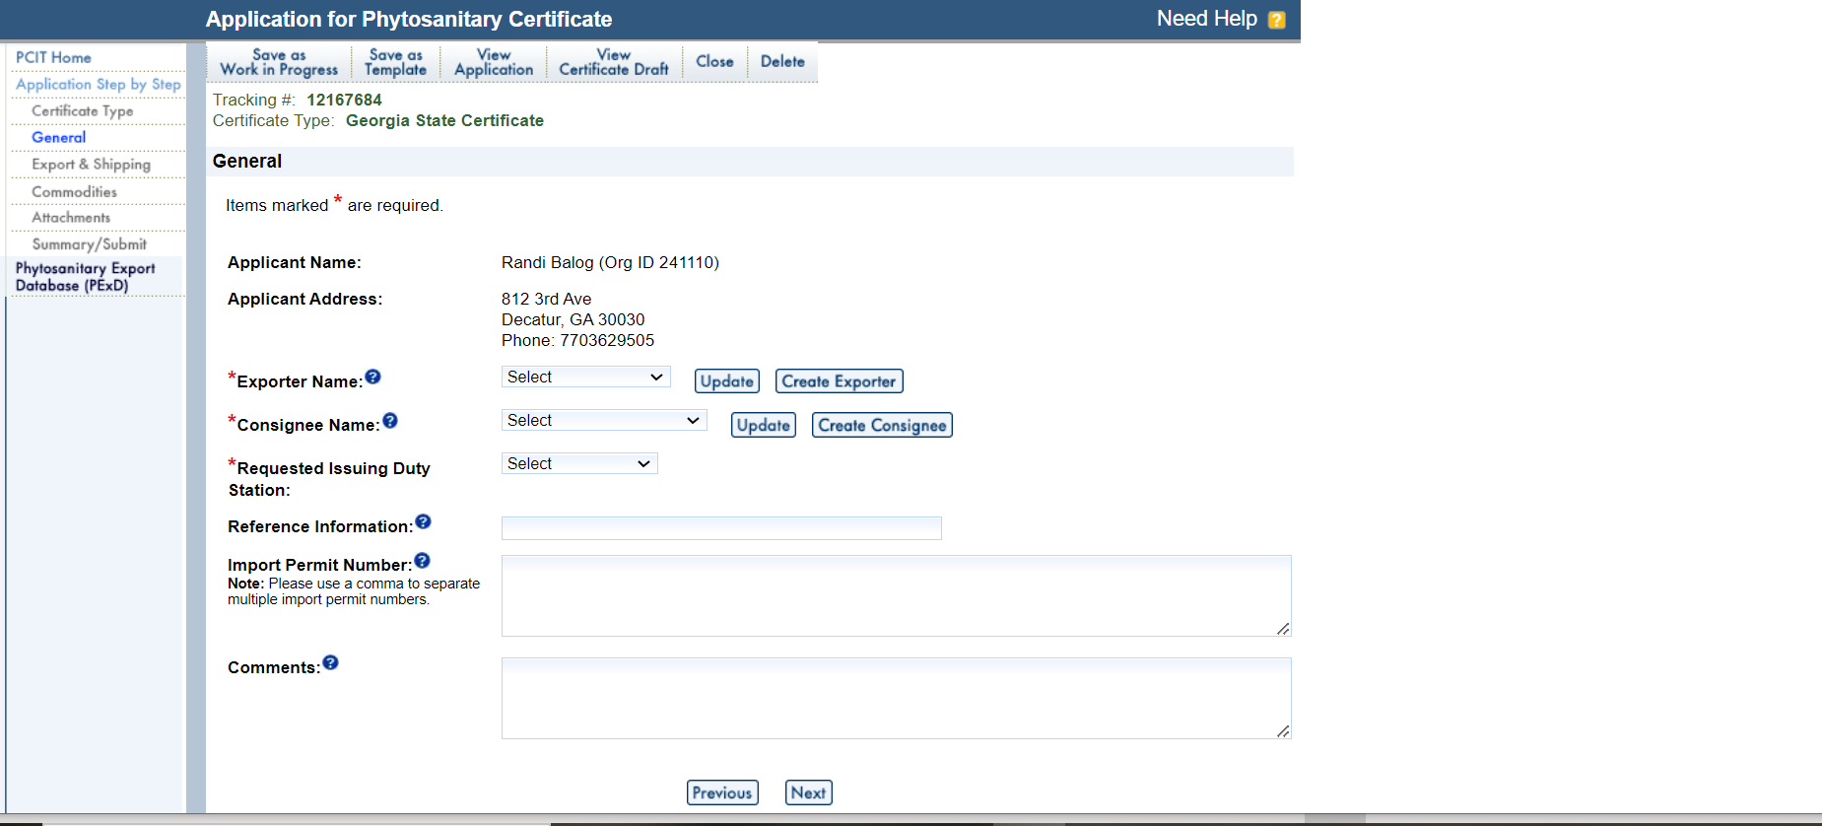
You will be able to choose a template, consignees and exporters. Bottom left is the beginning of an application.

Slide 16
Continue to finish the application by choosing “Next” after each page.
Once the application is submitted, we will review and issue as long as all requirements have been met.

Slide 17
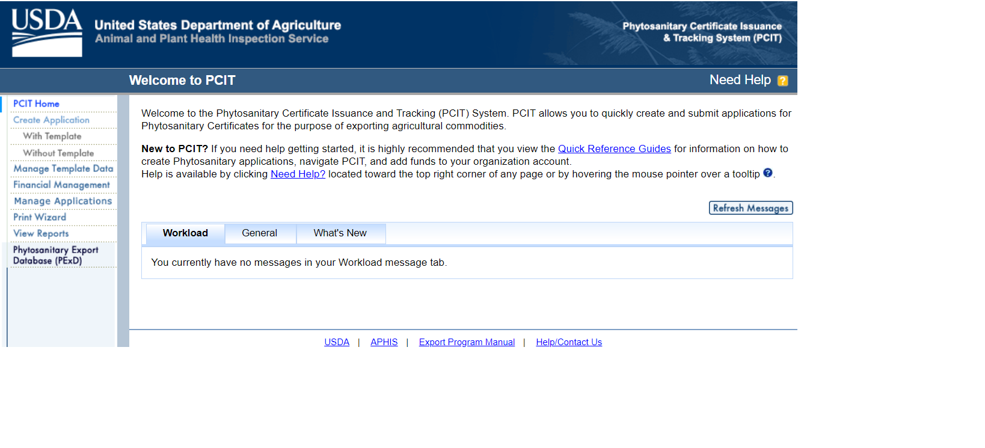
Payment for Certificates
Payment for certificates will be much easier.
You can load money into the Pay.gov sight per certificate or have a balance to pay for many certificates.

Slide 18
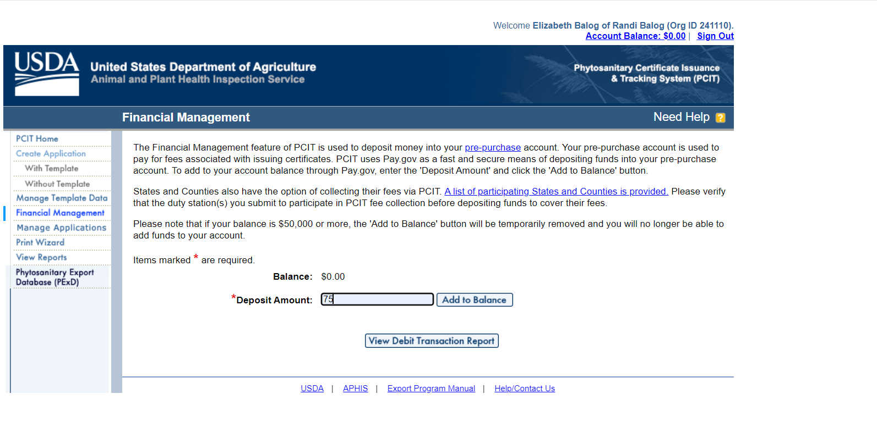
Choose “Financial Management” in the left menu board.
Add the amount desired
Choose “Continue to Pay.gov”

